Slide 1
Experimental data, Curve fitting/optimisation
PHYS3112 – Tutorial 2

Slide 2
Experimental data formats
Raw data is typically produced as a text file with the following format:
The top row contains
Each row is a new data point
Each column is a different data type (e.g. time, voltage …)
Columns will be separated with a special character ( comma , tab, space …)
x,y
1,10
2,20
3,30
.CSV
x y
1 10
2 20
3 30
.TSV
x-y
1-10
2-20
3-30
.txt using - as a separator

Slide 3
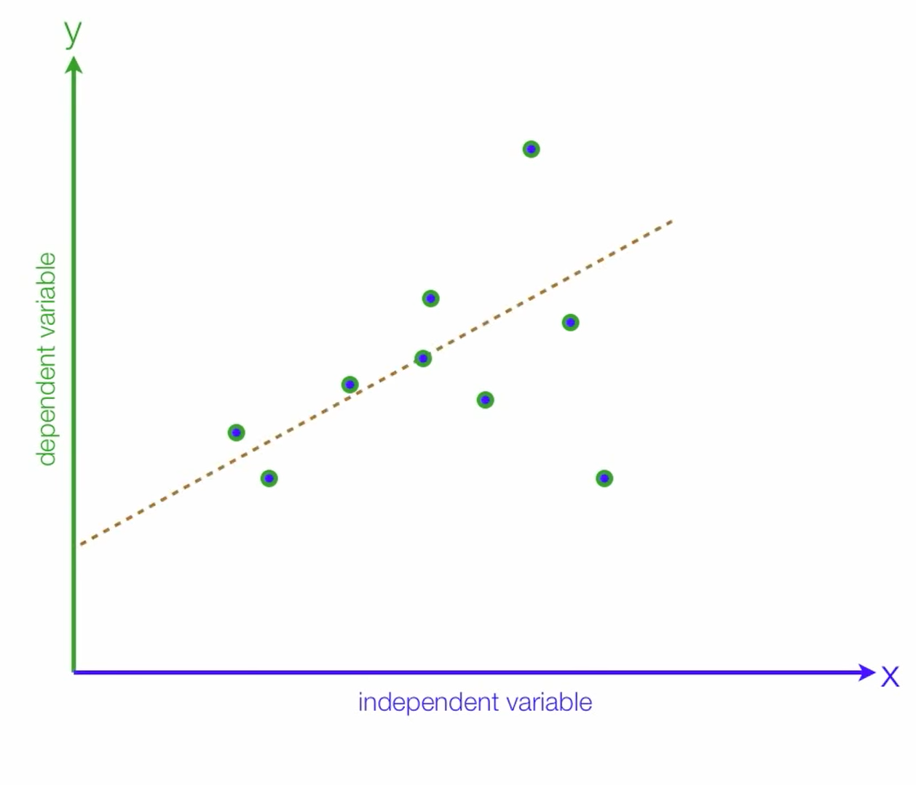
Curve fitting theory
Is this really a best fit?
Notes:
Let’s say you have some data points. You draw a line through it as your best fit (also known as regression line) but how do you know it is really a best fit?

Slide 4
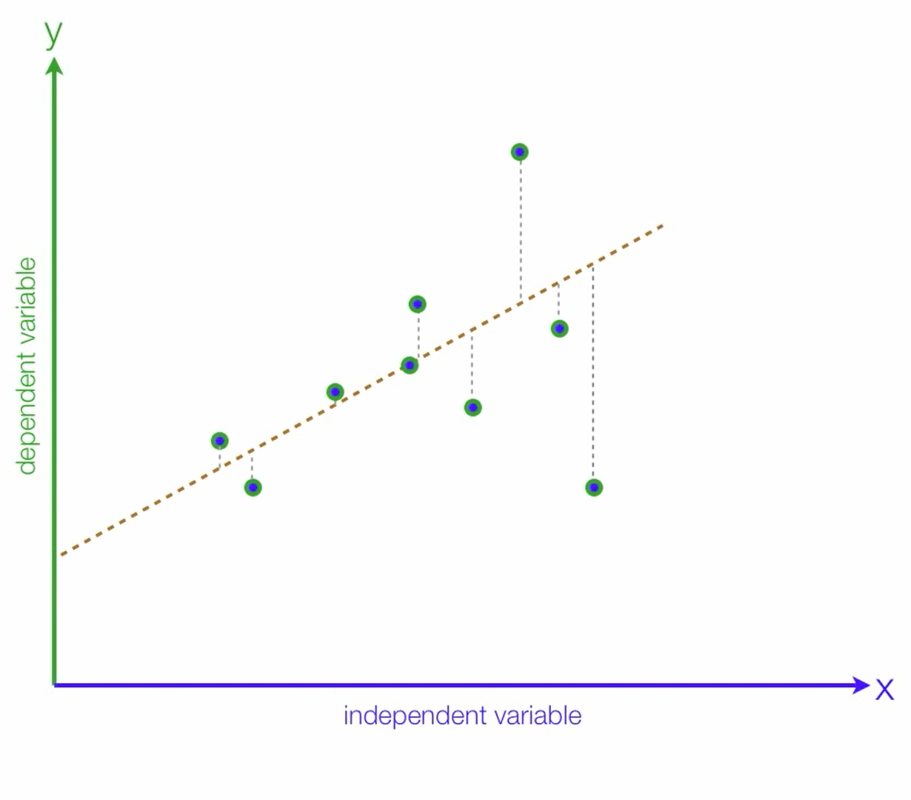

Curve fitting theory
$$Error=\sum{y_{data}−y_{best fit}}$$
Notes:
So we define some way to measure how good of a fit our best fit is. This is called an error function, and this is the simplest version.
So how do we get a better fit?

Slide 5
Solution #1: Brute Force!
Try moving the line around as many times as possible and pick the line with the lowest error (guess and check)
PROs:
Very easy to code
You can be confident you have found the global minimum (more on this later)
CONs:
Very slow
Scales VERY poorly with more complexity (imagine trying it in 3D)

Slide 6
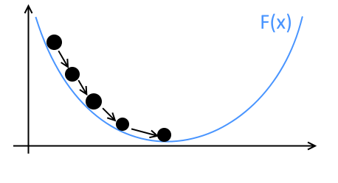


Solution #2: Gradient Descent
Gradient descent are a class of iterative solutions that use the function gradient.
At each guess, some form of gradient is computed, and this is used to decide the next guess
There are a LOT of implementations of this principle! The best choice depends on the nature of the problem
You should be able to code a rudimentary GD yourselves.
This is how many AI learn (specifically Neural Networks)
$$Error(m,b)=\sum_{over all x}{y_{data}(x)−y_{best fit}(m,b,x)}$$
$$y_{best fit}\left(m,b\right)=mx+b$$

Slide 7
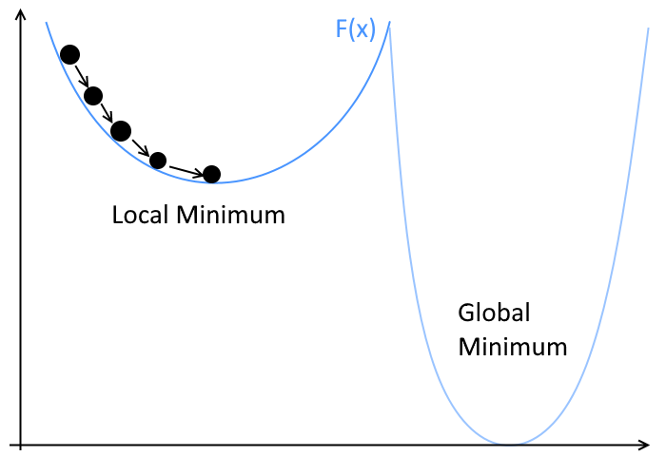
Global Vs Local Minimums
GD Solvers typically find the ‘bottom’ of whatever local potential they are in!
This means they tend to find the local minimum, instead of the global minimum.
Solutions?
Randomize the starting location – hope you get put in the global minimum potential?
Add some randomness into the descent process!
Notes:
This is why choosing good starting parameters is important

Slide 8
Many more optimisation methods
Simulated annealing: randomly jumping around but spots with lower error are given a higher probability or being jumped to.
Genetic algorithms: Make a generation of random solutions, keep a few of the best in that generation and slightly tweak (mutate) their parameters to make a new generation.

Slide 9
Things to Consider in your Choice of Method
To make a sensible decision as to our optimisation algorithm, we need to think about the problem.
Does the function evaluate quickly or slowly?
Can we evaluate the gradient of the function? How smooth do we expect the output to be?
Do we expect a single global minimum, or are there many local minimums to chose from?
Are our inputs discrete or continuous?

